Slide 1


Slide 2
Participants
138 students, 30 teams, 8 programs
MBD (Oct 22) | MCSBT SEPT 22 | BBADBA
Green Machine | Asan Dopollos | 404 Team Not Found
Bayes Dynamics | Big Data Bandits | Daemons
Cobras | Predictive Bits | BDBA
Data Miners | MCSBT & MBD OCT 22 | DataCrew
Datalgo | Zapata | GreenTech Solutions
Datavors | MBD PT 22 | PLEDBA
Exoticos | Bio-AI | Datatouille
GreenBeans | Tech4Planet
Rayo Avellano | BCSAI
Team lebanon | Bayes Genes
The Carbon Cutters | Climate Crusaders
Wildnovation | GLM^2
XGreenBoosters | mate
Eco(femme)ly | Respect

Slide 3


The problem (Phase 1)
Predict failure/incidence on a gas pipe network: binary classification.
Training data includes both characteristics of each pipe (~10 variables) and previous inspections on the network, including severity of the damage found.
You are given inspections on the pipe network up to the end of 2020 (around 6.5 million rows)
You are required to predict incidences on the revisions that took place in 2021 and 2022 (around 900K rows, one for each pipe)
Predictions will be scored with the AUC metric (area under the ROC curve)

Slide 4
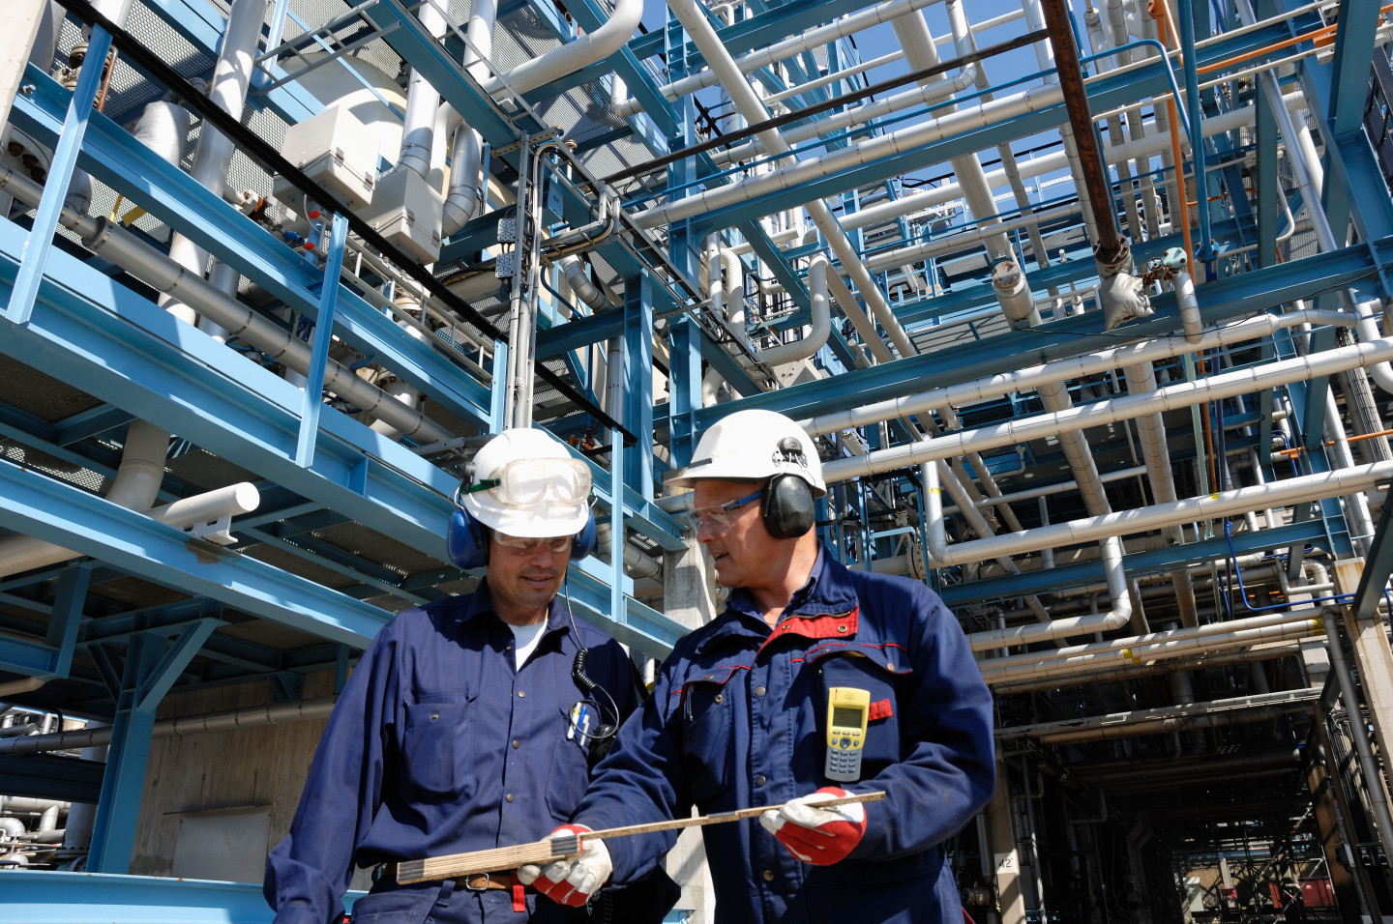
The problem (Phase 2)
Use your prediction model trained on data to devise an inspection strategy for the gas company
Try to model how much your inspection strategy can contribute to:
reduce operational costs
reduce carbon footprint (avoid gas to be released into the atmosphere)
improve efficiency
Support your proposed strategy with evidence based in data.
Be creative, ask for information you might not have, do extra research, etc.

Slide 5

The spicy stuff
A very large dataset:
1.4 million pipes
7 million inspections
Highly imbalanced classes
incidences occur 1-2 times every 1000 inspections.
Categorical features with many values
e.g. “town” has +2,000 levels (number of different towns in Spain)
Feature engineering
You’ll need to be creative to think of predictive features for each pipe based on the dataset of previous inspections
Face memory issues, sparse data, computational tractability, etc.

Slide 6
Evaluation criteria
Business
Technical
Efficient data storytelling
New Insights
Strategy modeling
Asking the right questions
Pitch clarity
Data wrangling
Exploratory data analysis
Feature engineering
Model performance metrics

Slide 7
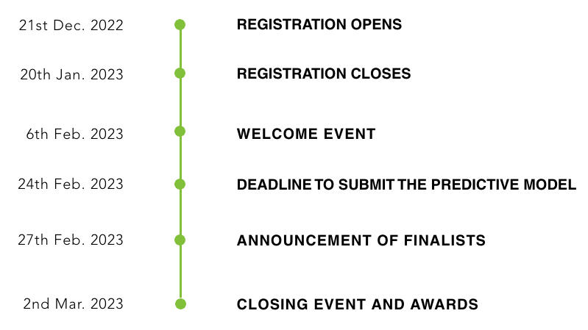
Timeline and deliverables
By Feb 24th your team will be required to hand in:
your notebooks with EDA, feature engineering, model training and results (conveniently explained in comments)
An executive summary (3-5 pages) describing your inspection strategy and its economic & environmental impact (you can support the report with graphs in appendices, if needed)
Finalists announced on Feb 27th: 3 extra days to prepare your pitches for Mar 2nd

Slide 8

Tips
Structure your team according to expertise
Work in parallel on Phase 1 and Phase 2
Leadership and organization
Keep your motivation high !
numbers matter, but ideas matter more
Start simple, then elaborate
Start with a plain vanilla model to set some benchmarks
Iterate the cycle and improve on different phases
Use your mentoring sessions well
Prepare your questions for the mentors

Slide 9






Mentors
First Mentorship
Feb 13-14
Second Mentorship
Feb 20-21

Slide 10

Questions ?

